Slide 1


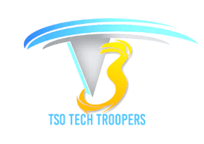



Spring MVC
TECH TALKS
Ravindra Nikam
Presenter of the topic

Slide 2

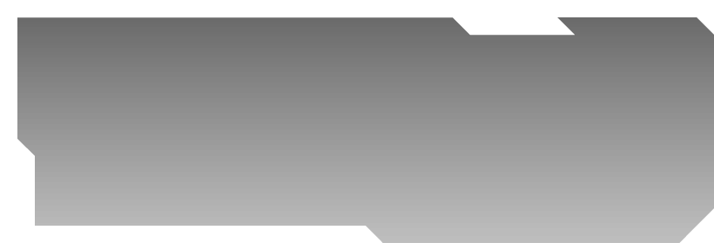

Spring MVC
Introduction
MVC Servlet
Spring MVC
MVC Servlet and Spring MVC demo
Reference
Notes:
Important suggestion,
We know these are challenging times. ISP may struggle sevice continuity, we may face power outage.
Stay connected to talk session and with available backup option we reconnect session immediately

Slide 3
Introduction
A web application (or web app) is application software that runs on a web server, unlike computer-based software programs that are run locally on the operating system (OS) of the device. Web applications are accessed by the user through a web browser with an active network connection. These applications are programmed using a client–server modeled structure—the user ("client") is provided services through an off-site server that is hosted by a third-party. Examples of commonly-used web applications include: web-mail, online retail sales, online banking, and online auctions.
Servlets are based upon a low-level API for handling requests and responses. Web frameworks like Spring MVC are designed to make building web applications, which handle HTTP requests and responses, easier. Most Java web frameworks, including Spring MVC, use servlets behind the scenes.

Slide 4
Introduction
You CAN use servlets to write a web application, but you'll have to handle all of the details manually. You'll get very little help with typical web stuff like validation, REST, request/response body for JSON, form binding, etc. You will end up writing lot of utility code to support your web application.
Web frameworks, on the other hand, are designed to make all of this stuff simple. With Spring MVC, you aren't bothered with manually handling the request and response even though you can still get access to them if you need to. Simple. With servlets, you'd have to do lot of stuff manually.
A Spring MVC is a Java framework which is used to build web applications. It follows the Model-View-Controller design pattern. It implements all the basic features of a core spring framework like Inversion of Control, Dependency Injection.

Slide 5
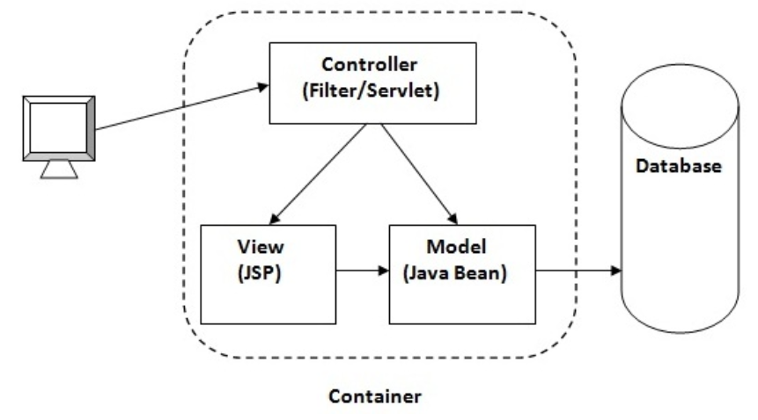
MVC Servlet
Advantage of MVC (Model 2) Architecture
Navigation Control is centralized
Easy to maintain the large application
Notes:
Servlet is the first step to learn java Web application development however Spring is a framework for J2EE application development famous now a days Servlet: a server side java class to produce the html content. however Spring: A framework to develop Big Enterprise Application which include your servlet also

Slide 6
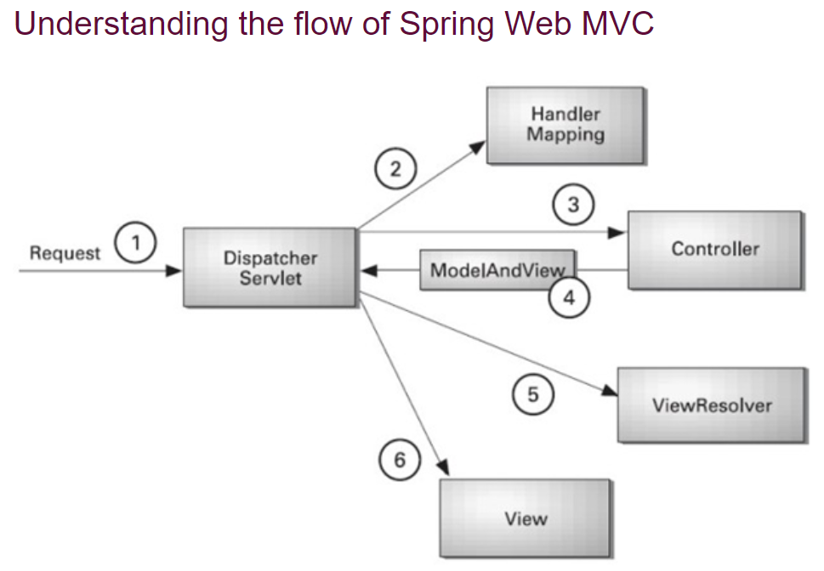
Spring MVC

Slide 7
References
https://www.javatpoint.com/MVC-in-jsp
https://www.javatpoint.com/spring-mvc-tutorial

Slide 8
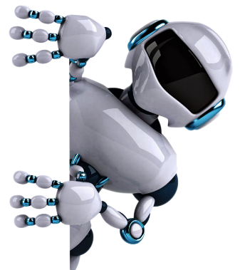
THANK YOU

Slide 9
Advantages
Advantages of Spring MVC Framework
Separate roles - The Spring MVC separates each role, where the model object, controller, command object, view resolver, DispatcherServlet, validator, etc. can be fulfilled by a specialized object.
Light-weight - It uses light-weight servlet container to develop and deploy your application.
Powerful Configuration - It provides a robust configuration for both framework and application classes that includes easy referencing across contexts, such as from web controllers to business objects and validators.
Rapid development - The Spring MVC facilitates fast and parallel development.
Reusable business code - Instead of creating new objects, it allows us to use the existing business objects.
Easy to test - In Spring, generally we create JavaBeans classes that enable you to inject test data using the setter methods.
Flexible Mapping - It provides the specific annotations that easily redirect the page.

